Slide 1

Zowie, Parik, ZhangXiang, Siddarth

Slide 2
Hypothesis
“Low prices, low delay rates with quality service will lead to higher customer satisfaction which in turn, generates higher revenue.”

Slide 3
Table of contents
01
02
03
04
Zowie
ZhangXiang
Parik
Siddarth
“Fare Per Mile is most affected by time of flight”
“The quality of a flight experience can affect passengers choice of flight”
“Customer service are the primary contributing factor to availability of passengers”
“Weather conditions are the primary contributing factor to airline delay”

Slide 4
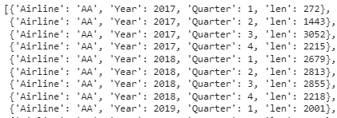
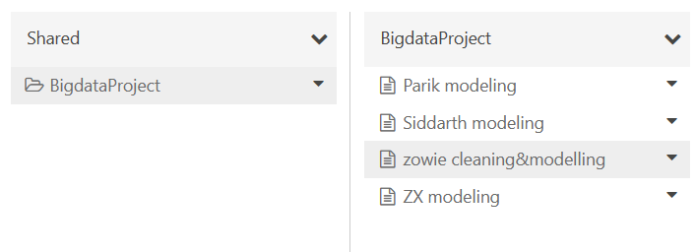
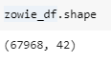
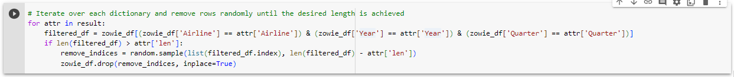
Integration
Folder structure
Merging of data files
Notes:
We created a shared databricks folder that can be accessed by everyone, we also used merged data from 3 data sources, which allowed for the use of features from different sources in our individual analysis

Slide 5
01
Zowie
“Fare Per Mile is most affected by time of flight”

Slide 6
Overview
Goals
Investigate the extent of impact of time of flight on fare per mile, to prove the hypothesis true or false
Uncover the top factors that affect fare per mile
Target Column
Fare Per Mile

Slide 7
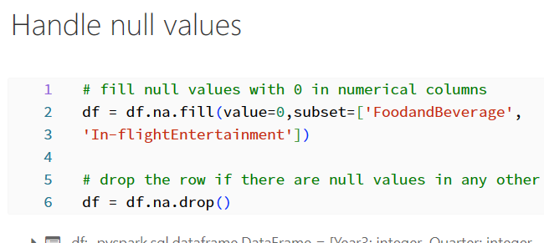
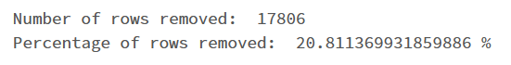
Data Cleaning feedback
Handling of null values
Initially, when removing all rows with null values without any other imputations, 24,038 rows, 27.5% of rows were removed
This is a fairly large percentage and may be removing valuable data point as well
Hence, I impute null values in FoodandBeverage and In-flightEntertainment with 0
I then removed rows that contained null values in other columns. Imputing values in other columns would disrupt the distribution, and affect the resulting analysis to be skewed/biased
Therefore, a lower percentage of rows were removed.

Slide 8
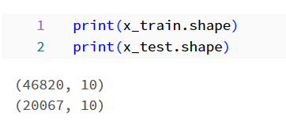
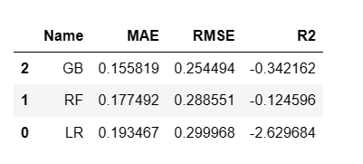
Modeling
Data is split into 70% training and 30% test data
Model comparison is done between 3 models
Linear regression
Random forest - ensemble model
Gradient boosting regressor - ensemble model
Used mean absolute error (MAE) as the main performance metric used to evaluate model performance
Gradient boosting regressor model performed the best with a MAE of 0.156
Notes:
If linear regression performs well then no need to spend more resources on ensemble models

Slide 9
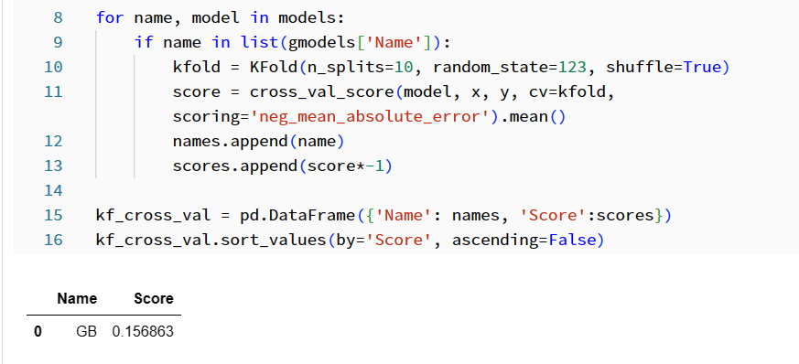
Modeling - kfold cross validation
After performing k-fold cross validation on the model, the resulting MAE is 0.157, which is not significantly better than the initial results

Slide 10
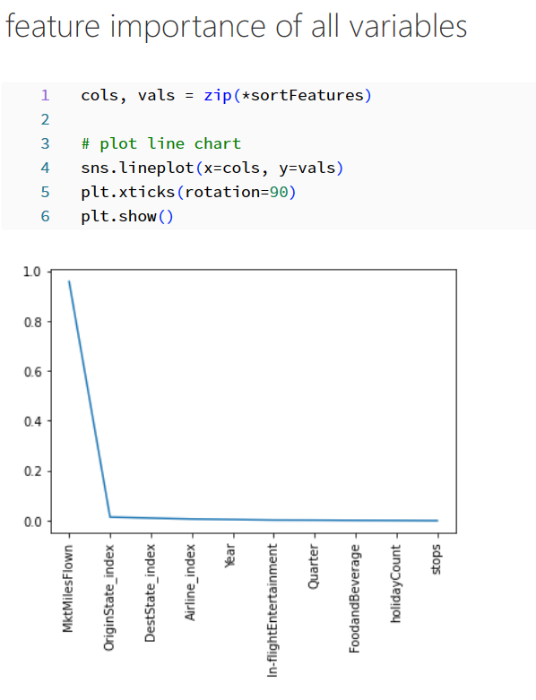
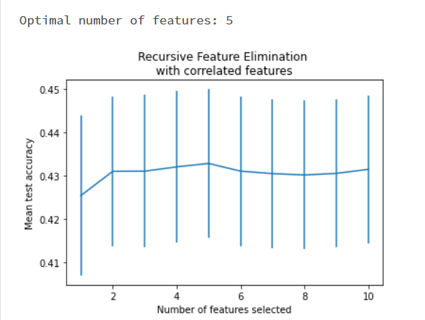
Feature selection
Through RFECV, the optimal number of features is 5
Thus, by looking at the feature importances from the model, I used the top 5 features to perform modeling again.

Slide 11
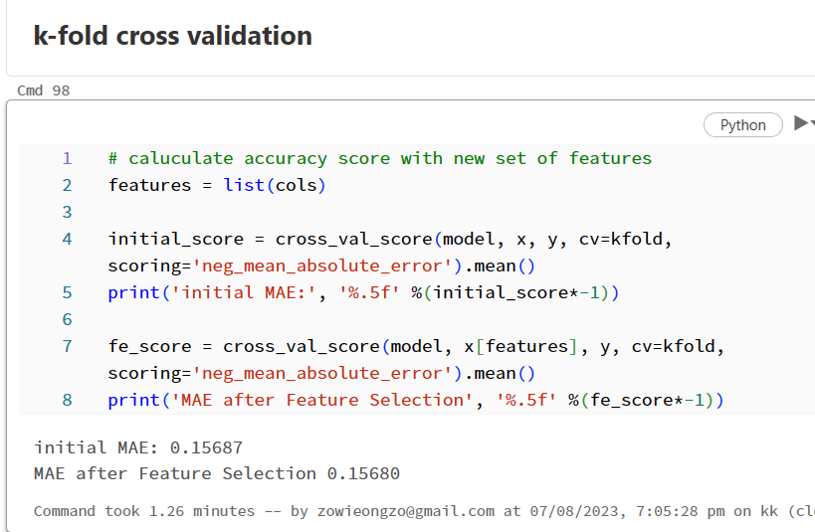
Feature selection
MAE decreased when kfold cross validation is performed on the new model using the top 5 features.

Slide 12
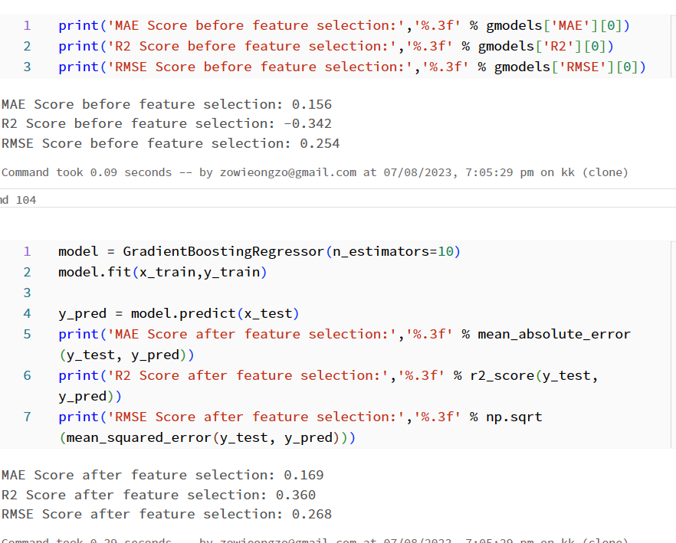
Feature selection
In a normal prediction, MAE and RMSE increased very slightly, meaning that there is more error between actual and predicted values after feature selection.
However, R^2 score increased significantly, from negative to a positive value. This indicates that the model fits the data better after feature selection. (line of best fit)

Slide 13
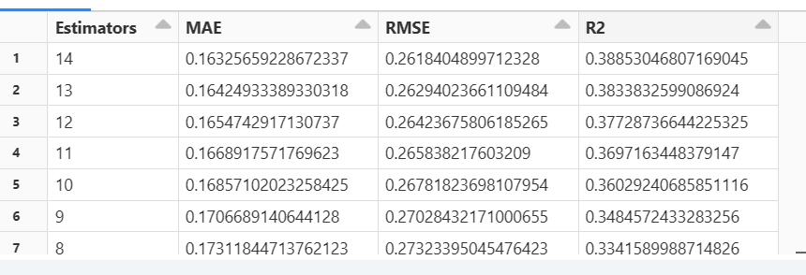
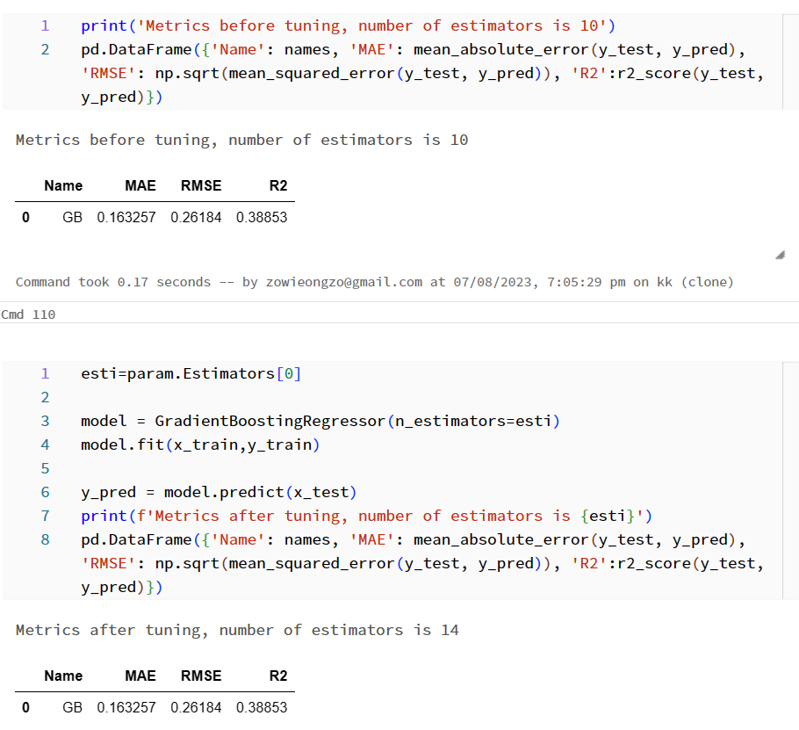
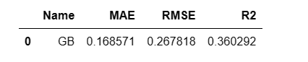
Hyperparameter tuning
Looped through a range of 5 to 14 for number of parameters.
Too many estimators will be too resource consuming for a simple task like this use case. Hence, i chose 14 as a limit, to prevent overfitting as well.
Initial no. of estimators = 10, the model with 14 base estimators performed best, where the metrics improved slightly.
This is also due to the increased number of base estimators.

Slide 14
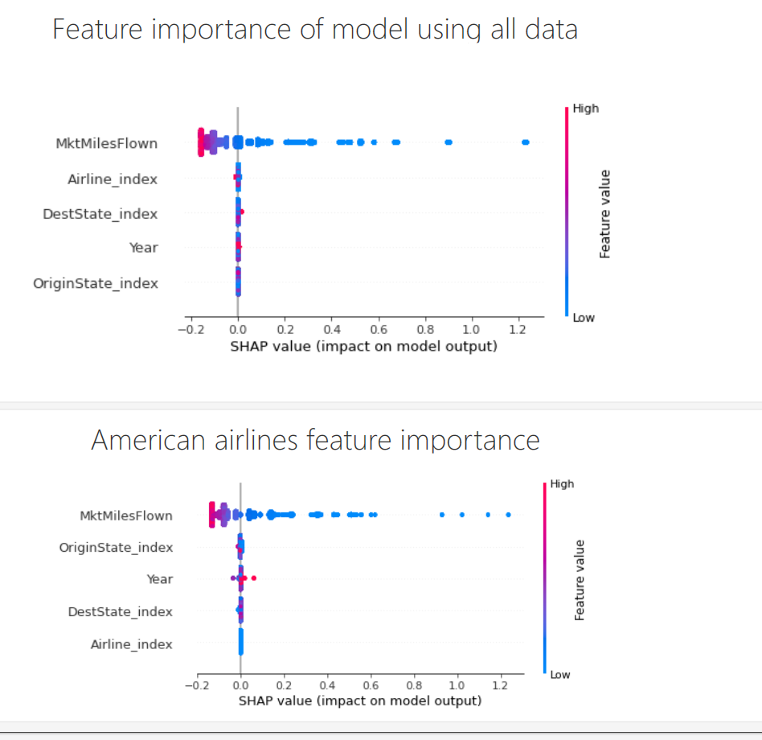
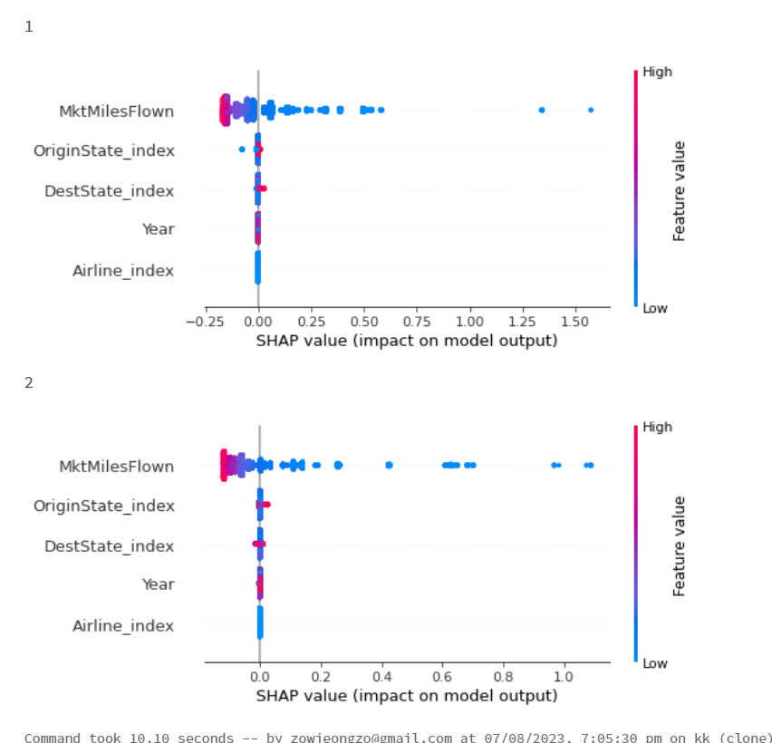
Model interpretation
Using SHAP values, I can see which features greatly affect the local predictions
Competitor analysis
Another 3 models were created for each airlines’ individual data, to see the important factors for each airline.
Delta airlines
United airlines

Slide 15
Insights
miles flown and origin state are the most important features for all models
year has a higher impact on ticket prices for American Airlines
destination state has a higher impact for Delta and United Airlines
This indicates that the research hypothesis should be rejected, as the time of flight does not affect ticket price to a large extent. Instead, miles flown and origin state has a more significant effect.

Slide 16
02
Zhang Xiang
“The quality of a flight experience can affect passengers choice of flight”
Notes:
Now I will walk you through sentiment classification with hypothesis statement of “The quality of a flight experience can affect passengers choice of flight”

Slide 17
Overview
Goal: Improve Airline flight service by finding out what customer care and what Airline is lacking.
Build
Sentiment Classification (Numeric Rating/Text): Understanding customer satisfaction or dissatisfaction from reviews and comments. (Positive/Negative)
Topic Modelling: Gain a deeper understanding of what customer are interested of through text, categorizing/clustering topics into different groups.
Aspect Based Sentiment Classification (With Transformer): Identifying sentiments associated with specific aspects or features experienced on the flight. (Positive/Neutral/Negative)
Target Column
Sentiment
Notes:
The goal is to identify what customer interest and solve problem faced by customer.
Therefore, I have a sentiment classification based on Numeric rating and another with text to find out customer satisfaction through reviews.
Also, Topic Modelling to groups similar topic and identify customer interest.
Last I did a Aspect Based Sentiment Classification with a pre-trained transformer to identify sentiment for certain aspect.
The target is to predict the Sentiment.

Slide 18
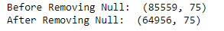
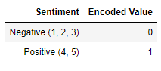
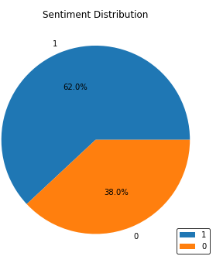
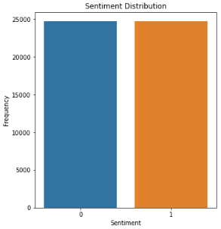
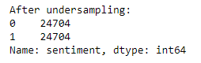
Data Preparation / Cleaning
General Cleaning
Drop Null
Remove Outlier (Year Columns: Found 2500+)
Remove Duplicates (From Web-Scraping)
Remove Null/Missing Value (Drop rows with null)
Remove Rows with Non-English Text ()
Encode Sentiment
Data Balancing (Random Undersampling)
Sentiment Encoded
After Data Balancing

Slide 19
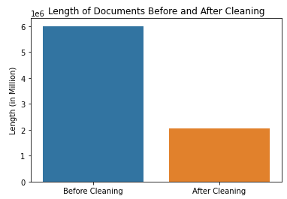
Data Preparation / Cleaning
Text Cleaning
Join review_header + reviews = combined_reviews
Remove Emoji Icon😊
Lowercasing Text (IDenTIfy => identify)
Remove URLs, Email & Number
Expand Contraction (I'm = I am)
Remove Punctuation (!!!!????...)
Remove Stop Words (i will spent => spent)
Remove Spelling Error
POS Tagging Lemmatization (ate(VERB) => eat)

Slide 20
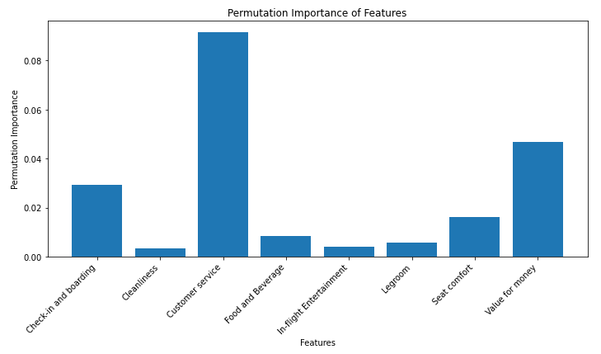
Sentiment Classification - Numeric Features
Features Used (Importance in Modelling)
Target: Predict Sentiment (Positive or Negative)
Notes:
For Numeric Sentiment Classification, looking at the feature importance, these are the variable that is chosen to predict the sentiment.

Slide 21
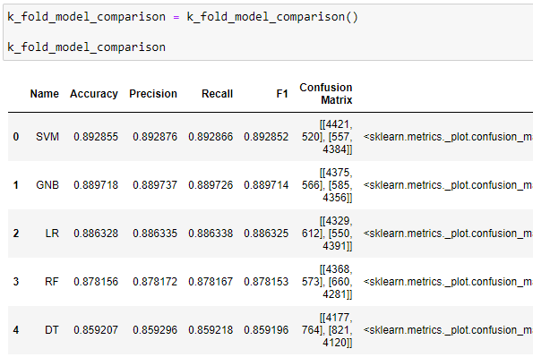
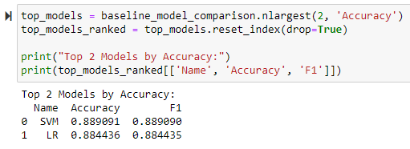
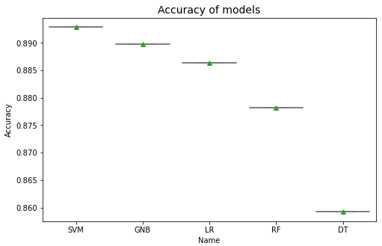
Sentiment Classification - Numeric Features
K-Fold Cross-Validation Model Comparison
Select Top 2 Best Model for further Tuning
Notes:
I had did a k-fold cross validation to make sure all data is cross-trained to prevent overfitting and choosen top 2 models for further tuning, the top 2 models are SVM and LR with highest Accuracy and F1 score.

Slide 22
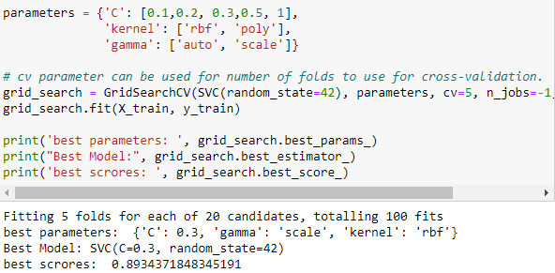
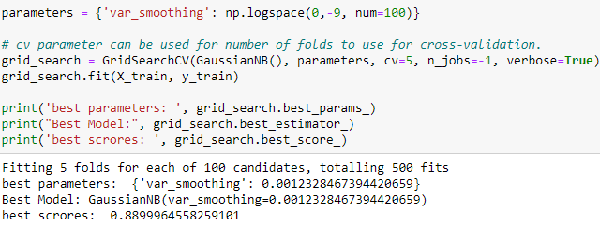
Sentiment Classification - Numeric Features
Hyperparameter Tuning for the top-2 Models
Notes:
After that Conducting a Hyperparameter tuning to optimize the model and select best model through it scores and visuals.

Slide 23
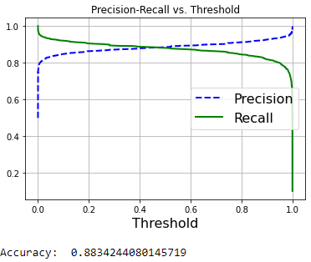
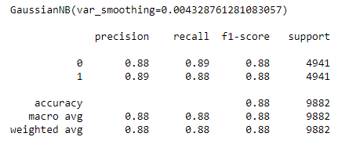
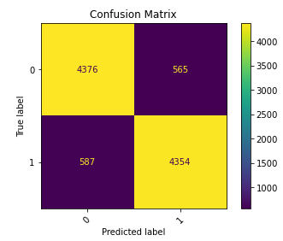
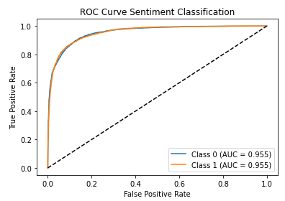
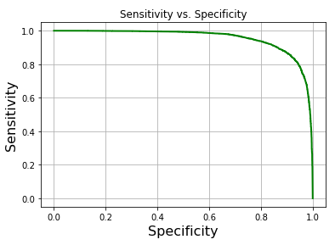
Sentiment Classification - Numeric Features
Selected Best Model: Gaussian Naive Bayes
Notes:
These are the visuals that I have used to identify the best model. Finding out that Gaussian naive bayes perform much faster and it performance is better than SVM through these visuals.

Slide 24
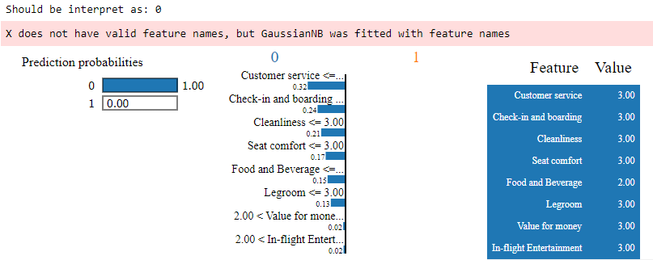
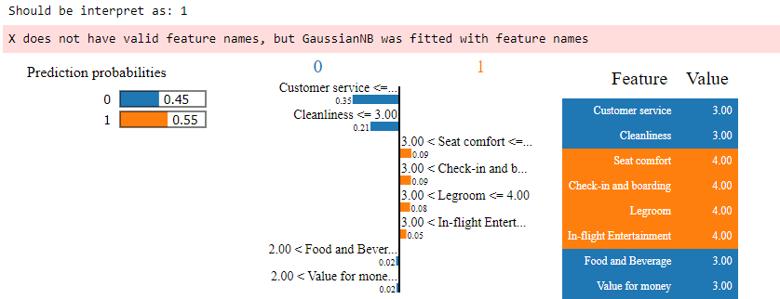
Sentiment Classification - Numeric Features
Notes:
With that using the best model trained to explain on why it make such decision, as you can see for class that should be negative which is 0 are predicted correctly as 0 with reasoning on factors that support it.

Slide 25
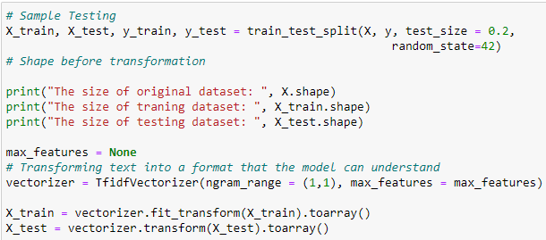
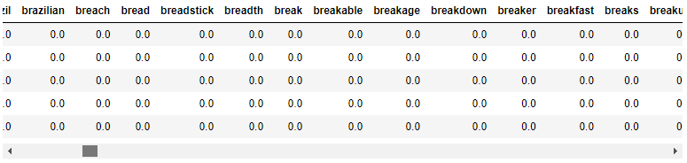
Sentiment Classification - Text
Vectorize Data with TFIDF (Unigram) - Best Performance
After several testing with models, Unigram and vectorizer of TFIDF perform better than Bigram and CountVectorizer.
Bigram & Trigram produces more than 60k columns of features, do not have enough RAM to support as well.
Features Used (Vectorized Text after cleaning)
17000+ Features Generated
Notes:
For Text Classification, after cleaning the text I perform several test on the type of method to vectorize them, in the end find out that with TFIDF of Unigram it perform the best, and below are the vectorized sample of text.

Slide 26
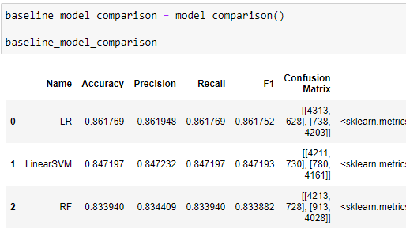
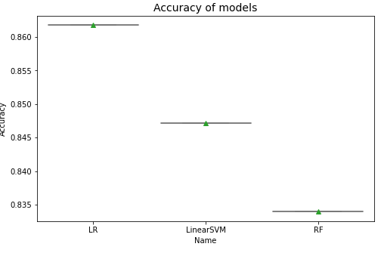
Sentiment Classification - Text
Model Comparison
Select Top 2 Best Model for further Tuning
Notes:
Same I did model comparison and select the top 2 models Logistic Regression and LinearSVM.

Slide 27
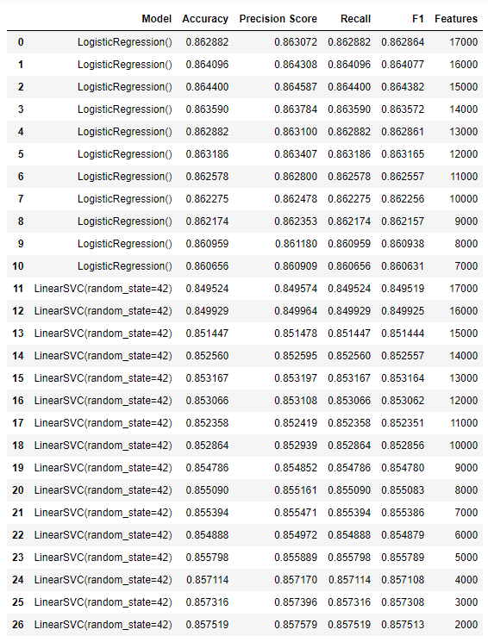
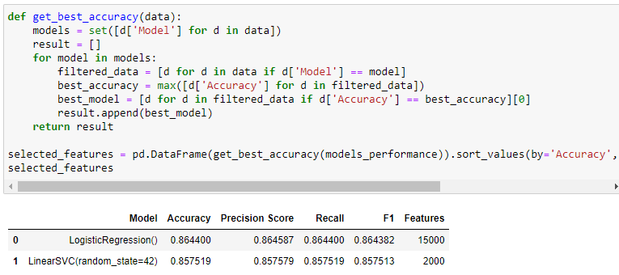
Sentiment Classification - Text
Feature Selection (Chi-Square)
A higher chi-squared value is generally considered better for feature selection purposes because it suggests a stronger association between a feature and the target variable
Logistic Regression Best Features: 15000
LinearSVC Best Features: 2000
Notes:
Went on to perform Feature selection with chi-square to remove unnecessary features in prediction and reducing dimension space, showing that Logistic Regression has best features of 15000 and 2000 for LinearSVC.

Slide 28
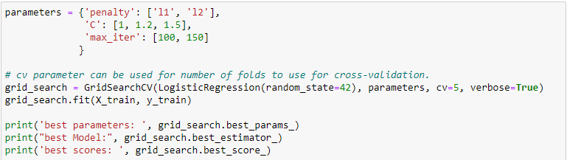
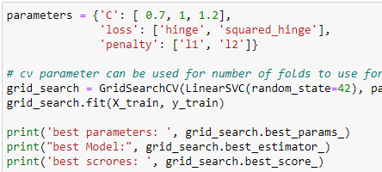
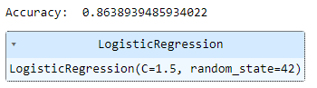
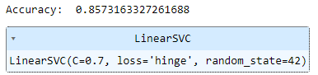
Sentiment Classification - Text
Hyperparameter Tuning for the top-2 Models
Notes:
Then I will use it for hyperparameter tuning and select best model.

Slide 29
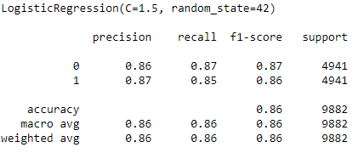
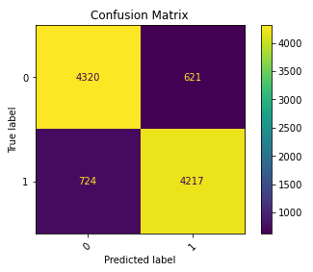
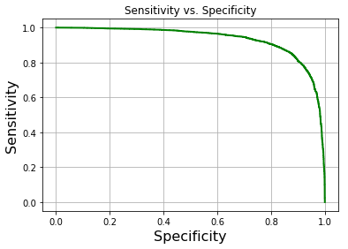


Sentiment Classification - Text
Selected Best Model: Logistic Regression
Notes:
In conclusion Logistic Regression Perform best and able to identify most classes correctly through visuals.

Slide 30


Topic Modelling
Model Comparison through coherence
Performed all model below with BOW/TFIDF:
Latent Dirichlet Allocation (LDA)
Latent Semantic Indexing (LSI)
Hierarchical Dirichlet Process (HDP)
Identify best model through assessing Coherence and Perplexity
Coherence measures how semantically similar the words are in a topic. A high coherence score indicates that the words in a topic are closely related and make sense together.
Perplexity measures how well a topic model can predict new or unseen data. A low perplexity score indicates that the topic model is confident and accurate in its predictions.
Best Topic Model at 13 Topics: LDA_BOW
Notes:
Next, Topic Modelling where I did it with 3 different models with both vectorizer method of Bag of word and TFIDF. I will identify best model through assessing coherence and perplexity, in the end found that that best model is LDA_BOW, however the coherence of LDA_TFIDF have higher coherence score.

Slide 31


Topic Modelling
Topic Model Comparison through Visuals
Selected as Best: Able to identify distinct topics LDA_BOW : Second Highest
LDA_TFIDF : Highest
Notes:
The reason why I choose LDA_BOW as best model is because it is able to identify distinct topics better, instead of have 3 big clusters close together unable to get unique topics.

Slide 32

Topic Modelling
Some topics Extracted from Best Model
Notes:
TAking a look at what topics customer mentioned, for example looking as topic 3 is about delay of flight and topic 1, which is about leg room is small, through this airline is able to understand customer interest and make improvement.

Slide 33

Aspect Based Sentiment Classification
Pre-Trained Transformer in Sentiment Classification
Notes:
Next up is a Aspect based sentiment classification build with a pre-trained transformer, and I have created multiple aspects as I want to find out customer opinion towards each aspect.

Slide 34









Aspect Based Sentiment Classification
Example of Testing
Main 3 aspects involved in the sentence.
Other aspects not in the sentence.
Notes:
Looking at the text above it says, we had a great experience for the service at the flight, food was not too bad, but not enough space to stretch my leg.
From the text above this classification task is able to identify service is positive, food is positive but not too hight about 64% and having legroom of negative 99%.

Slide 35

Aspect Based Sentiment Classification
Notes:
With this model airline are able to build chart like above to visualize what they are lacking of and comparing themselves with other competitors in each aspect.

Slide 36
03
Parikshit
“Quality of services are the primary contributing factor to availability of passengers”

Slide 37



Data Cleaning
Removed rows with more than or equals to 4 nulls so that it is more accurate
Only lost 5% of data so not a big information loss
The missing columns i used to input missing values with knn of neighbour =3.

Slide 38


Binning columns
Binned the satisfaction rating to satisfied and neutral or dissatisfied
Binned the dept_time and arr_time.
It will help simplify the patterns and relationships within the data.

Slide 39


Model performance
Generally all models are performing very bad by using R-squared
Most of the models have 0 or negative r-square which means there is little or no relation to the target variable(Passengers)
The only good model is Random forest Regressor.
We can also see that many of the models are overfitting. Linear Regression,Ridge,XGBRegressor,LGBMRegessor

Slide 40

Outliers in target column
There are outliers in my target variable column as shown in the box plot.
Outliers might be causing the models be performing very bad as the r-squared is very bad.
Removed the outliers from passengers column for values above 200

Slide 41


Model performance after removing outliers
After removing the outliers, models are performing a bit better.
The mae and rmse have generally reduced compared to without removing outliers.
the model's(LR and Lasso) generalization performance has improved. It's better at making accurate predictions not only on the training data but also on new, unseen data.
There are still overfitting models like DT,extra trees.
Our best model,Random forest regressor, got better by 0.01 for R-squared.
The rmse on training reduced from 3.09 to 2.72. The rmse for testing has reduced from 2.67 to 2.60. The difference between the training and testing rmse has decreased which suggests that the model is overfitting less to the training data.

Slide 42

Passenger column skewed
Original distribution has unequal variance and non-constant spread of data points across the range
After doing the transformation,the distribution is still not as good but it is better
Need to transform using boxcox function so it is more spread out
can help stabilize the variance for different variables
improve the linearity and distribution of the data

Slide 43


Model performance after skewed
After skewing, models are performing way better. All the values have improved to positive for example AdaBoost.
KNN and Random Forest regressor are the best models.
The rmse and mae has dropped alot after skewing.

Slide 44
Model performance comparison
Before skew
After skew
We can see that after skewing our r-squared has increased which means it has helped the model better capture the relationships within the data and has improved the overall fit of the model.
Our rmse has reduced from 2.60 to 0.0163. It means the errors have become smaller. By transforming the target variable, it is more suitable for modelling and have helped the model better capture the data's distribution.

Slide 45

Feature Importance
We can see from the chart that from Random Forest Regressor,the columns with the highest importance is
MktFare,
MilesFlown,
arrival time,
departure time
arrival delay
For all the flight services like in-flight entertainment,cleanliness,legroom has lesser importance.
The binned columns also had the least importance.

Slide 46


K-fold validation
Before
After
By choosing the top 25 features,i used k-fold validation to check the mse. The mse increased very slightly. The standard deviation reduced suggests that the model's predictions are becoming more robust and reliable across different scenarios.

Slide 47
Optimization of models
The rmse got worse after tuning as i used GridSearchCV. I will not tune the model and keep the previous one with 0.000186 rmse.

Slide 48
Evaluation
There was no use of Binning the columns as they were the least important factors in the dataset.
Customer service such as cleanliness,in-flight entertainment were not the most important factors contributing to remaining availability of passengers.
Some of the most important factor is the arrival and departure time and also the arrival delay. We can see that passengers do not like having delayed flights. If the airline has a history of being late, Passengers are less likely to take the flight. The fare price also is the most important factor.
From here we can conclude that the hypothesis is proven wrong as the customer service is not the most important factor.

Slide 49
04
Siddarth
“Weather conditions are the primary contributing factor to airline delay”

Slide 50
Overview
Projected Outcome of Analysis:
Analyse main leading factors that cause airline delays
Identify if there are trends or patterns in flight delays based on time of day or day of week
Discover if flights from certain airports are more prone to delays
Hypothesis Statement:
- Weather conditions are the primary contributing factors to airline delay
Target Column:
- Arrival Delay

Slide 51
Steps Taken
Modelling with imbalance dataset and outliers
K-Fold Cross Validation
Modelling Data with balanced dataset and no outliers
Feature importance and selection
Hyperparameter Tuning
Best Model Evaluation

Slide 52


Modelling with imbalance dataset and outliers

Slide 53


K-Fold Cross Validation

Slide 54



Modelling with balanced dataset and no outliers
1. Balancing Training Dataset

Slide 55

Modelling with balanced dataset and no outliers
2. Removing Outliers

Slide 56



Slide 57


Modelling with balanced dataset and no outliers
3. Modelling

Slide 58


Feature Importance and Selection

Slide 59



Hyperparameter Tuning

Slide 60


Best Model Evaluation

Slide 61

Best Model Evaluation

Slide 62




Best Model Evaluation

Slide 63


Best Model Evaluation

Slide 64
Conclusion

Slide 65
Hypothesis Recap:
‘Low prices, low delay rates with quality service will lead to higher satisfaction, generating higher revenue’.
Strategic Pricing Optimization:
Implement dynamic pricing models that align with customer preferences, optimizing revenue without compromising customer satisfaction.
Service Excellence:
Invest in comprehensive training for flight attendants to ensure courteous, attentive, and responsive service.
Elevated performance in flight time and reducing Delay time:
Recognize the significance of departure delay and put more focus by being consistently on time
Operational Excellence:
Enhance operational efficiency to minimize disruptions, improve on-time performance, and elevate passenger experience.

